Slide 1
BSc Digital & Technology Solutions Apprenticeship
Induction September 2025
Computing - Southampton Solent University
martin.reid@solent.ac.uk

Slide 2

Martin Reid
Apprenticeship Programme Manager Course Leader for:
Computing Foundation Level 4 Data Analyst Apprenticeship HNC (HTQ) Data Analyst BSc (Hons) Digital and Technology Solutions (Apprenticeships), Office: JM506
martin.reid@solent.ac.uk
Computing - School of Technology and Maritime Industries

Slide 3

Kenton Wheeler
Associate Lecturer in Computing
Office: JM506
kenton.wheeler@solent.ac.uk
Computing - School of Technology and Maritime Industries

Slide 4


Welcome
East Park Terrace Campus
DATS 1.2 Apprenticeship Standard
KSBs
Support & Communication
Review Meeting
Teaching Delivery
Study Days
Academic Calendar
Off-The-Job-Tracker
Solent Portal
Timetabling & Attendance Monitoring
Assessments & Grading
EPA & Portfolio
Student Course Representatives
Q & A

Slide 5
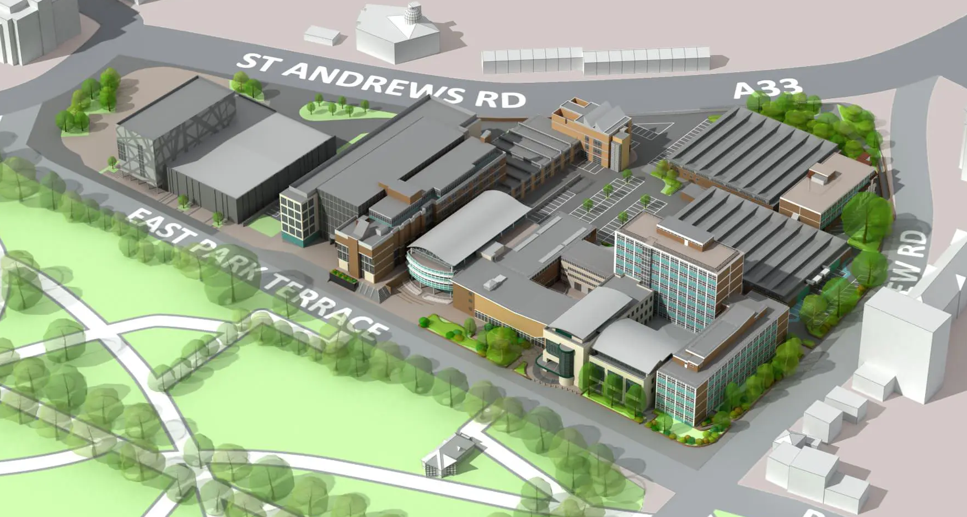
EAST PARK TERRACE CAMPUS

Slide 6
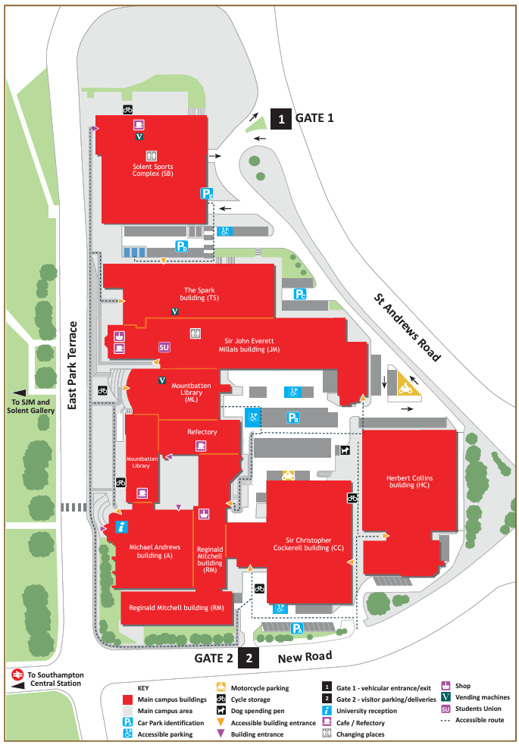
https://www.solent.ac.uk/about/documents/southampton-city-centre-map.pdf

Slide 7
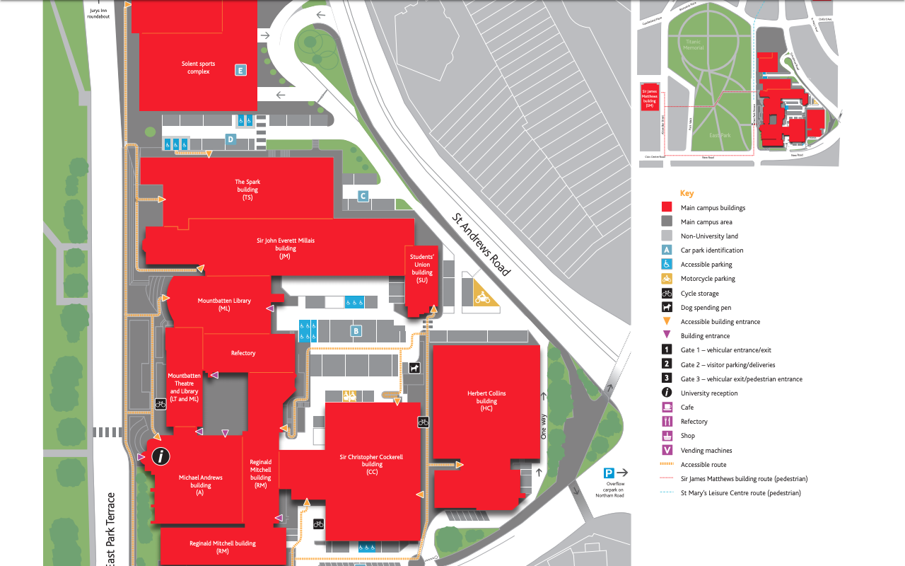
JM Building
Computing Staff Team
JM506
Students
Union

Slide 8
Apprenticeship Standard

Slide 9
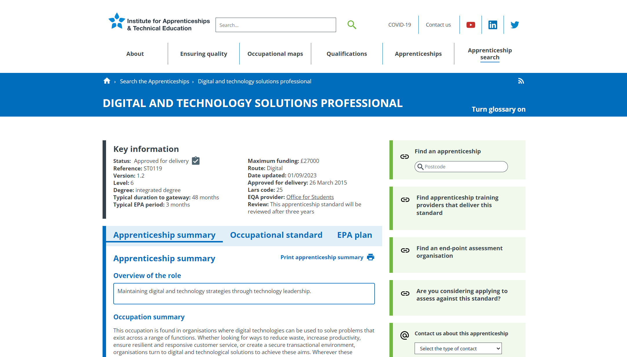
https://www.instituteforapprenticeships.org/apprenticeship-standards/digital-and-technology-solutions-professional-integrated-degree/

Slide 10

Software Engineer The primary role of the Software Engineer is to undertake all requirements during the solution development life-cycle from gathering requirements to analysis, design, code, build, test, implementation and support.

Slide 11
KSBs
KNOWLEDGE SKILLS BEHAVIOURS

Slide 12
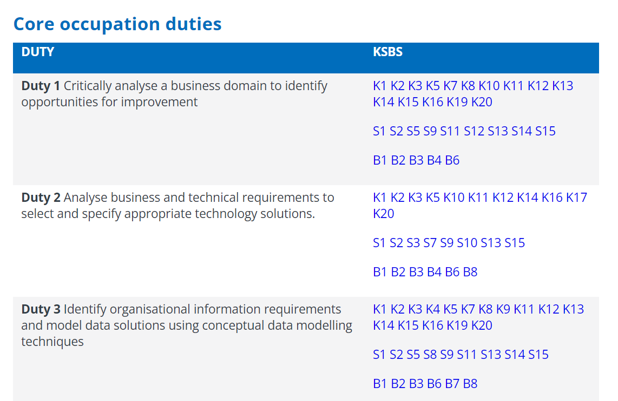

Slide 13
Support & Communication

Slide 14
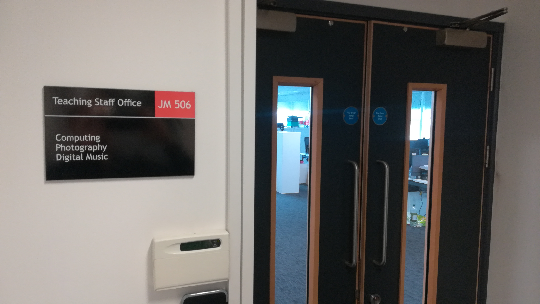
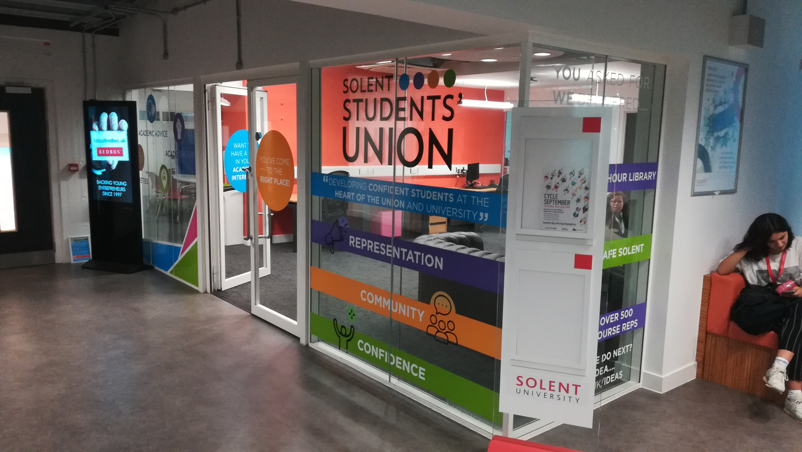
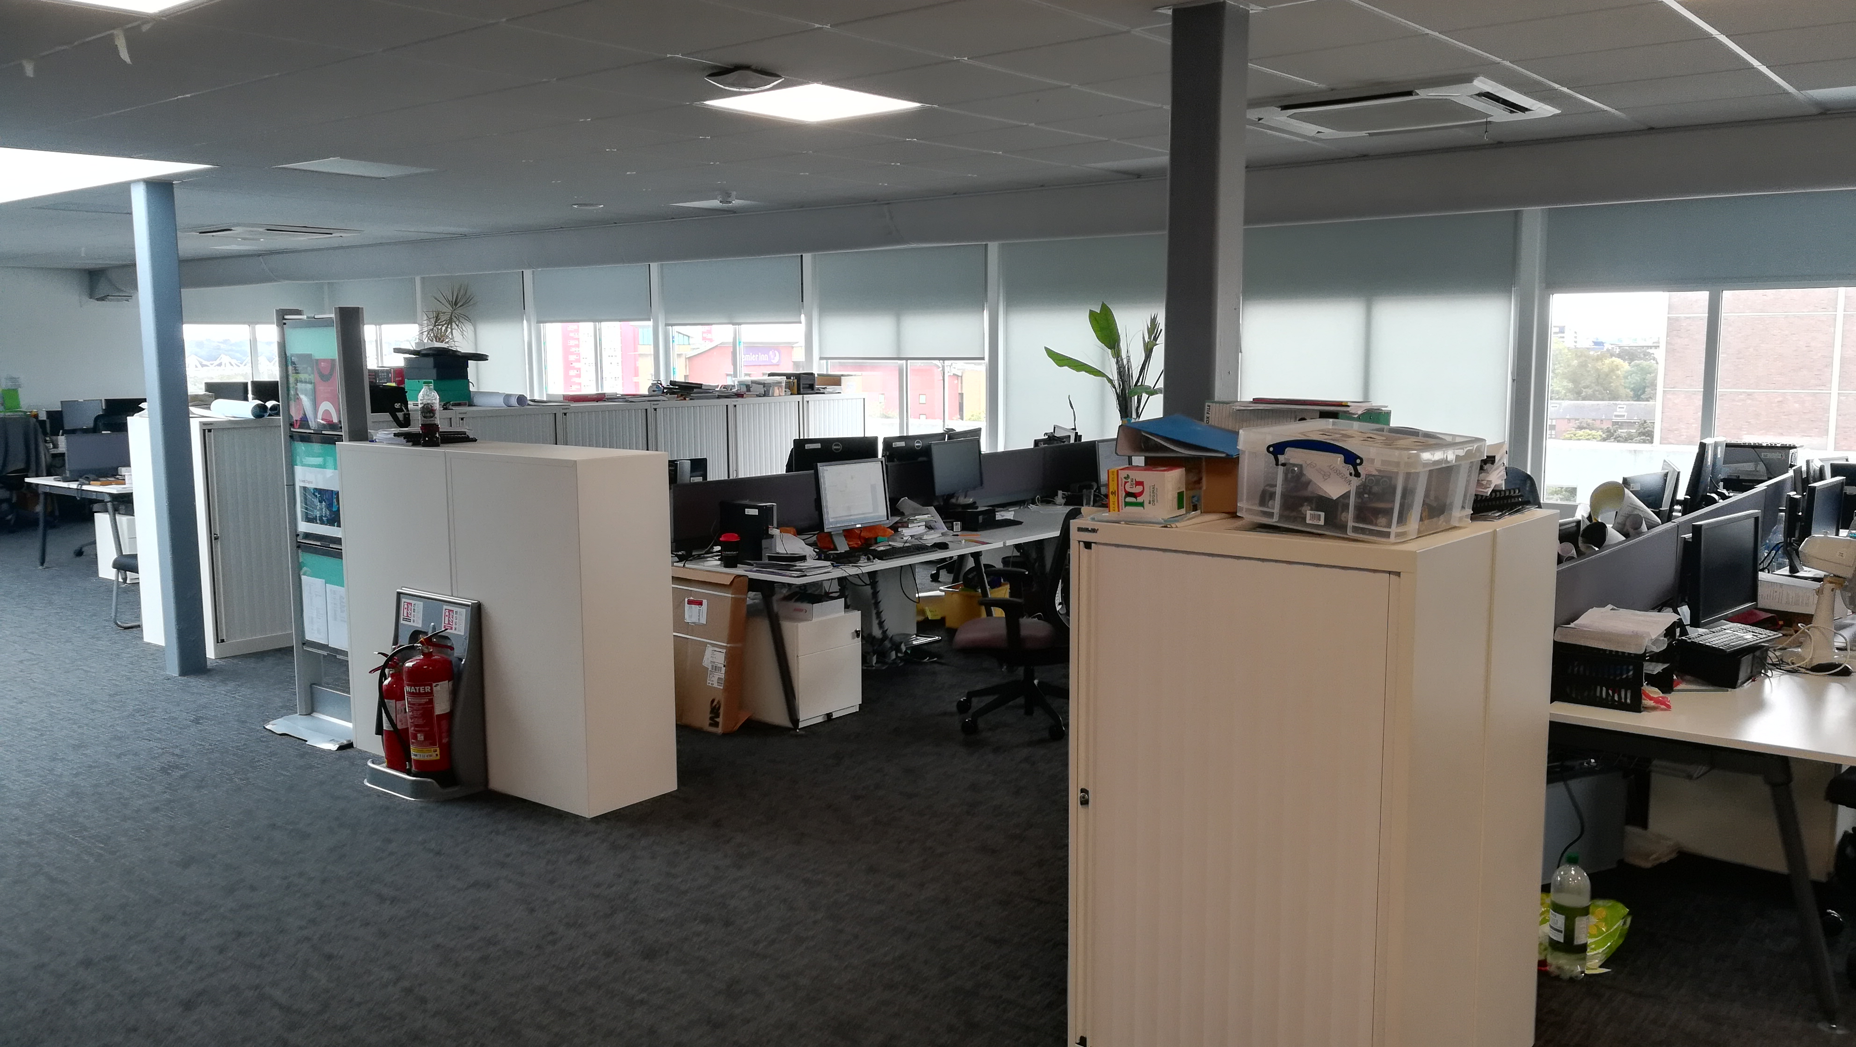


Slide 15


Slide 16
X
fluffybunny@hotmail.com
Use Solent student email
Full Name Student Number
Course & Level

Slide 17
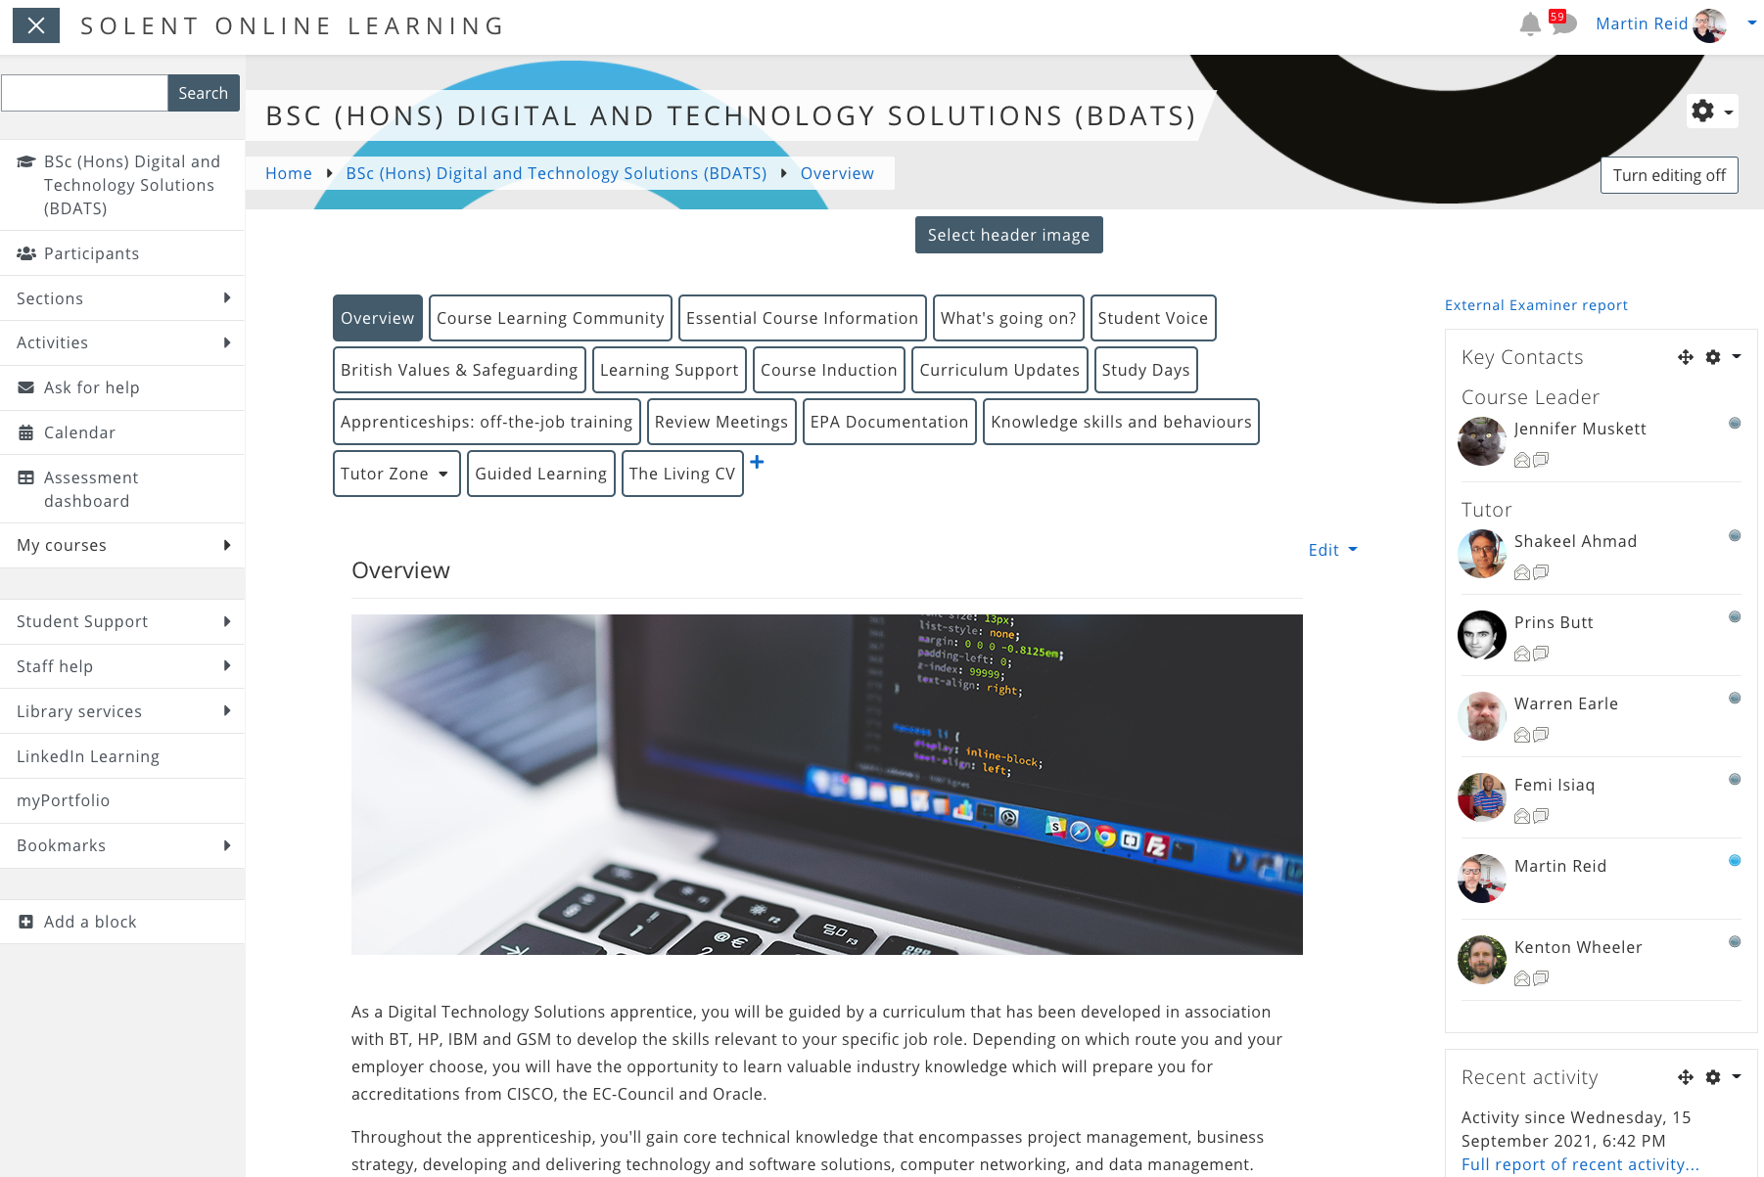
https://learn.solent.ac.uk/course/view.php?id=42080&section=0#tabs-tree-start

Slide 18

https://martinsolent.github.io/bdats_2/

Slide 19
Module/tutor Leader
Reviewer
Course Leader
Student Hub

Slide 20
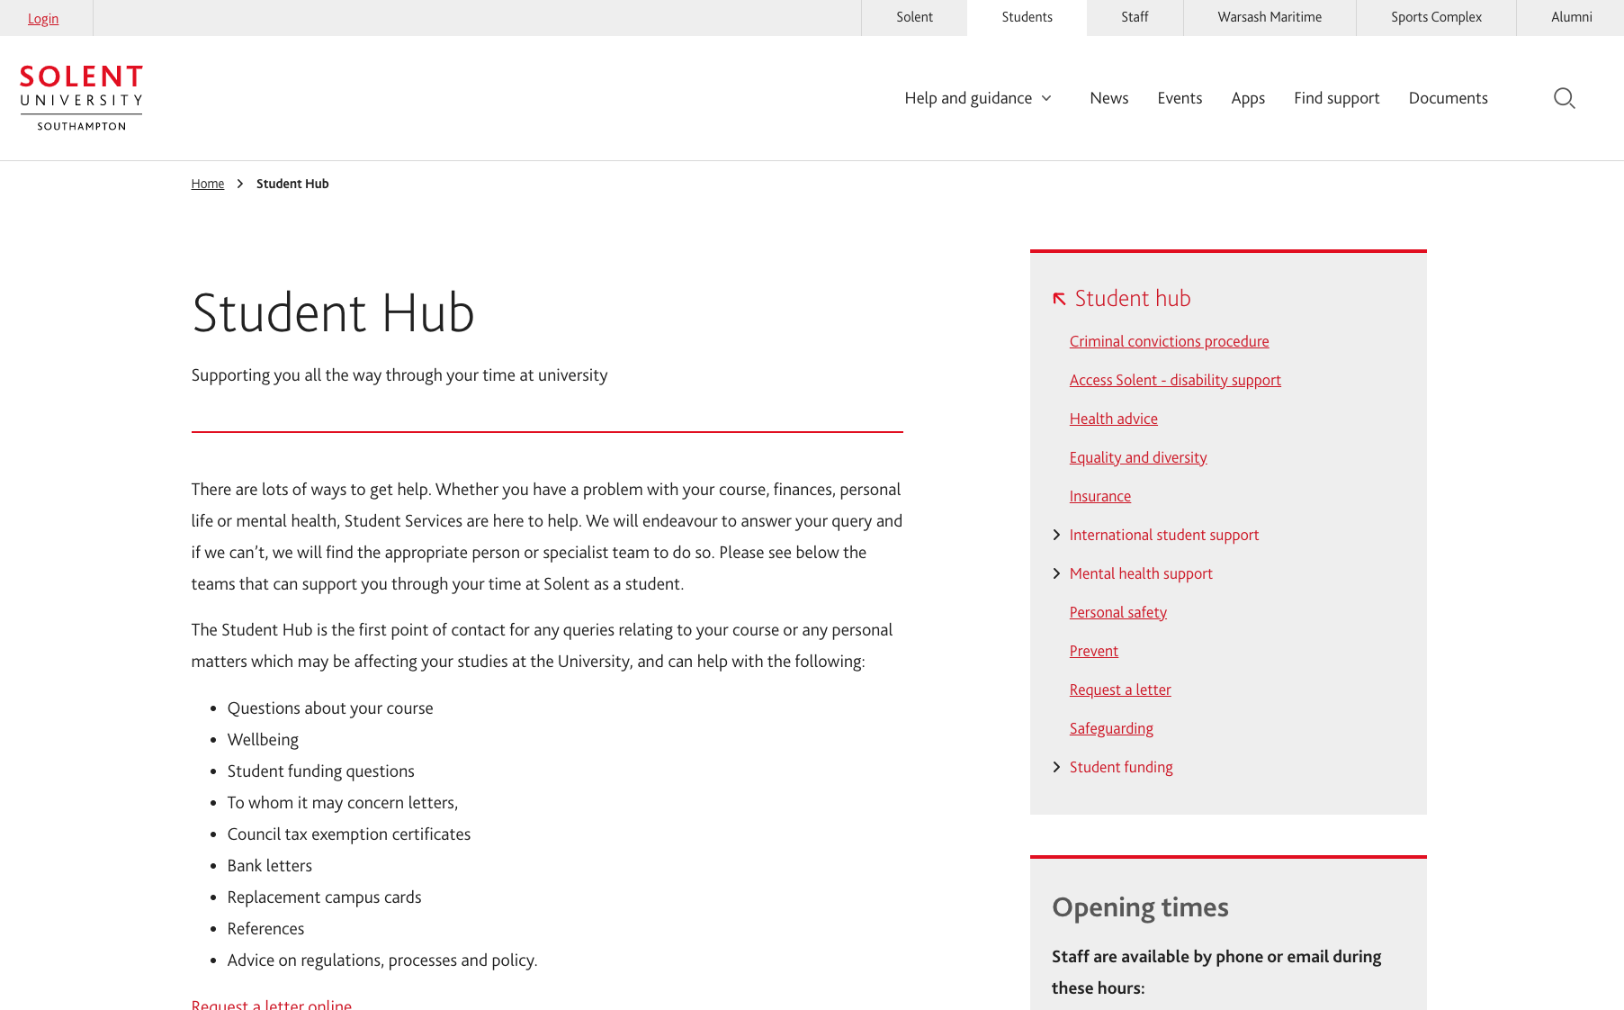
https://students.solent.ac.uk/student-hub

Slide 21

https://students.solent.ac.uk/student-hub/mental-health-support

Slide 22
Review meetings
Tripartite review meetings take place regularly throughout the apprenticeship and are usually held every semester.
At tripartite review meetings the apprentice, their employer, and an academic formally meet to assess progress and ensure that the apprentice is on track both in terms of their academic programme and their work-based learning. Your Reviewer doubles up as your personal tutor
https://learn.solent.ac.uk/course/view.php?id=42080&section=11#tabs-tree-start

Slide 23
TEACHING DELIVERY

Slide 24
Digital and Technology Solutions (integrated degree)
36 Months – on-programme
3 Trimesters per level Study 2 modules at a time (except the final 2 trimester) 3 Months – Gateway EPA

Slide 25
DATS - Software Engineering Pathway
Level 4
SEMESTER 1 – Sept - Jan
COM411 Problem Solving Through Programming
COM412 Intro to Networks and Security
SEMESTER 2 – Jan-May
COM417 Introduction to Databases
COM422 Software Testing and Reliability Engineering
SEMESTER 3 – May-Sep
COM423 - Systems Analysis & Design
COM421 - Data Structures, Algorithms & Maths
Level 5 – Sept - Jan
SEMESTER 1
COM519 Advanced Database Systems
COM528 Object Oriented Development
SEMESTER 2 – Jan-May
COM526 - Introduction to AI
COM527 Mobile Application Development
SEMESTER 3 – May-Sep
COM532 - Work Based IT Project Management
COM530 - Work Based Business Organisation
Level 6 – Sept - Jan
SEMESTER 1
COM624 - Machine Learning
COM619 DevOps
SEMESTER 2 – Jan-May
COM617 Industrial Consulting Project
COM618 - Data Science
SEMESTER 3 – May-Sep
COM628 - Gateway (Zero Credit EPA Prep)
Oct- Jan
COM627 EPA (40 Credits)

Slide 26

FACE-TO-FACE Campus Teaching Delivery
Opportunity for Hybrid learning on Summer modules (May-Sept)

Slide 27
Study Days
As a default we aim to have 1st years on Tuesdays, 2nd year on Wednesdays and Thursdays for 3rd years, but due demand on resources this is not always possible, but we will confirm study days in advance of you starting the course or progressing to the next level/year.
Study Day | Year (Level)
Tuesday | 1st Yr (L4)
Wednesday | 2nd Yr (L5)
Thursday | 3rd Yr (L6)

Slide 28
Study Days – Semester 1 (2025)
1st Year Modules | Study Day | Time | Room
COM412 - Introduction to Networks & Security | Tuesday | 9:00-12:00 | JM404
COM411 - Problem Solving through Programming | Tuesday | 14:00-16:00 | RM701
2n Year Modules | Study Day | Time | Room
COM519 - Advance Database Systems | Wednesday | 9:00-11:00 | HC216
COM534 - Oriented Design & Dev | Wednesday | 14:00-16:00 | JM304

Slide 29

ACADEMIC CALENDAR

Slide 30

Full-time Job

Slide 31
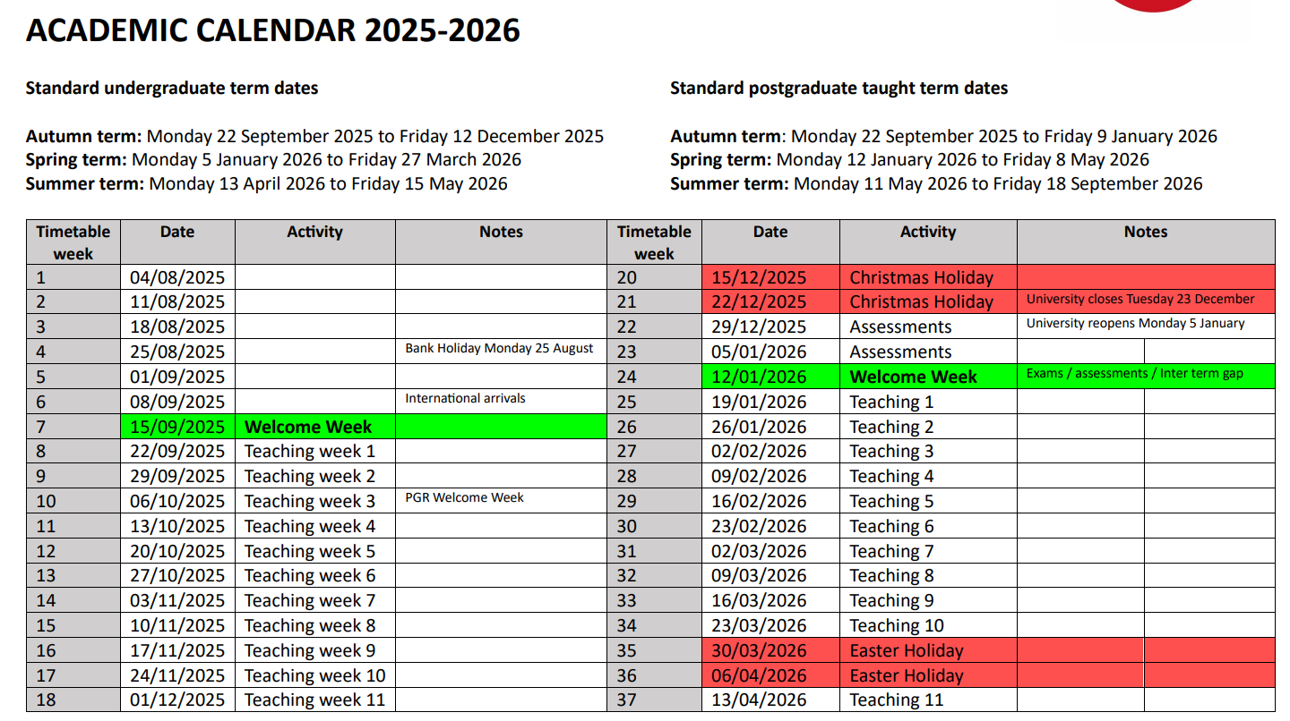
Academic calendar 2025/26

Slide 32
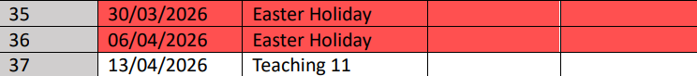
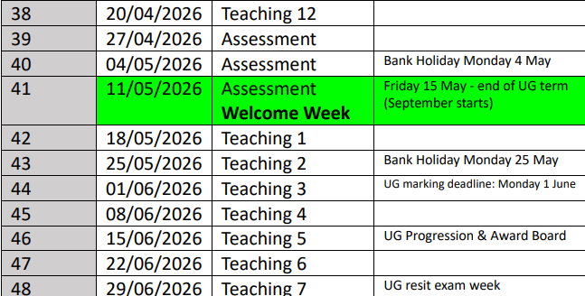
Academic calendar 2025/26

Slide 33
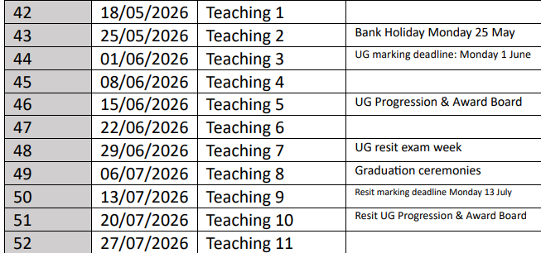
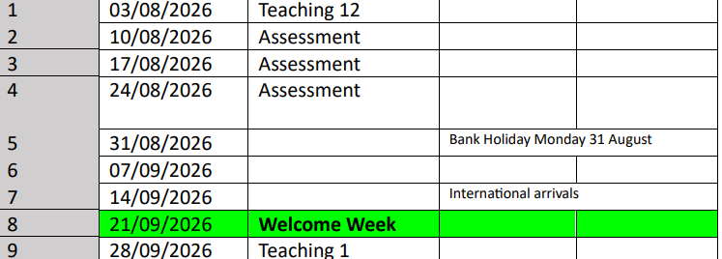
Academic calendar 2025/26

Slide 34

Off the Job Tracker
https://learn.solent.ac.uk/course/view.php?id=42080&section=10#tabs-tree-start

Slide 35
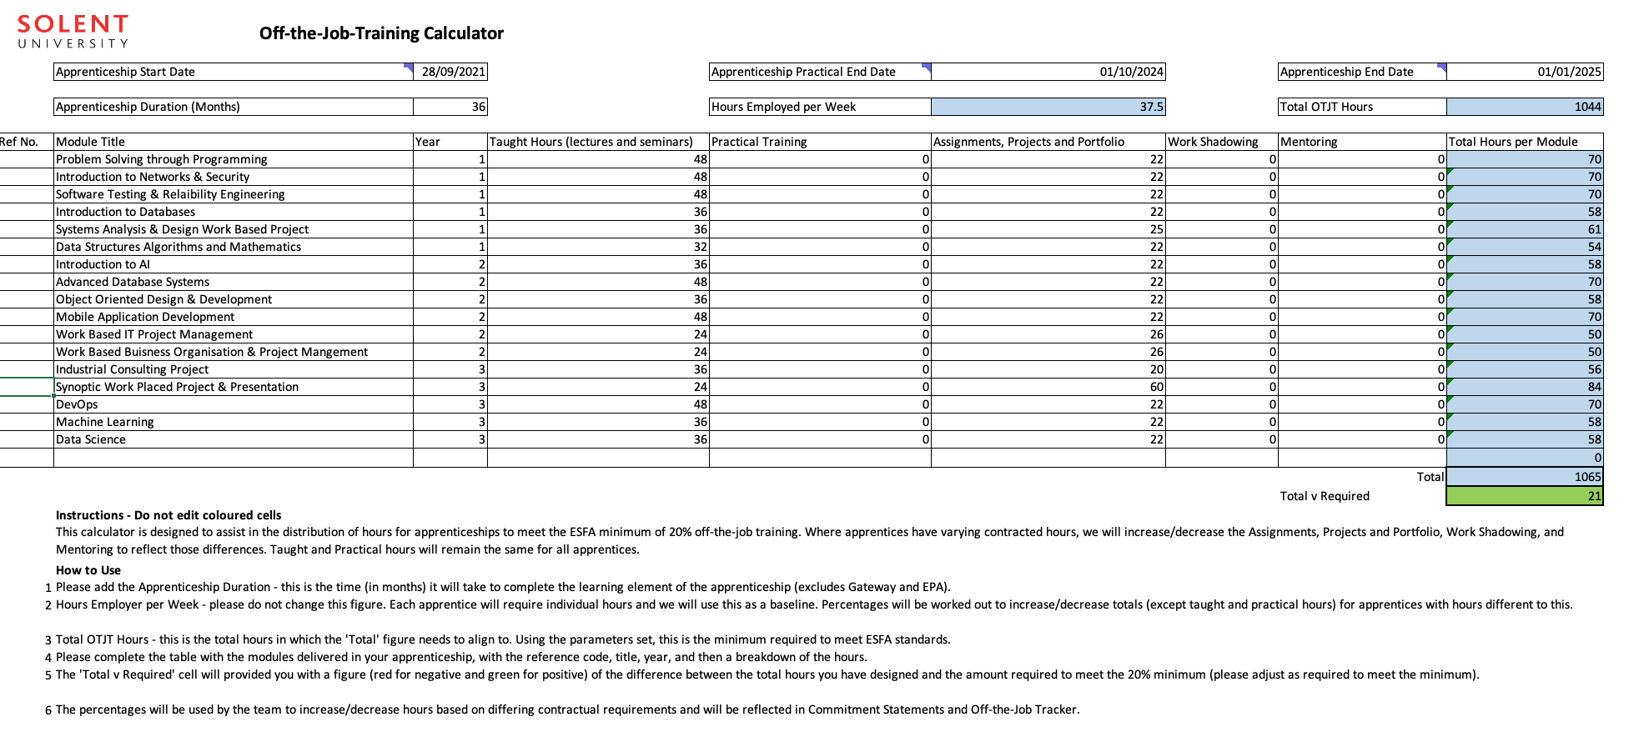

Slide 36

Calculating Off-the-job Training
When calculating the required amount of off-the-job training, the apprentice’s statutory leave entitlement must be deducted.
Employees who work a 5-day week receive 28 days paid statutory leave (20 days annual leave plus 8 Bank Holidays), which is the equivalent of 5.6 weeks of holiday.
The apprentice’s own annual leave entitlement, which may be higher than the statutory leave allowance, must not be used in the calculation.

Slide 37
Calculating Off-the-job Training
Therefore, for a full-time apprentice following a 12-month apprenticeship, off-the-job training is delivered over 46.4 weeks (52 weeks minus 5.6 weeks of statutory leave).
DEPARTMENT FOR EDUCATION, 2023. Apprenticeship off- the-job training Policy background and examples to support the 2023 / 2024 apprenticeship funding rules [viewed 2 May 2024]. Available from: https://assets.publishing.service.gov.uk/media/6530efdb92895c000ddcba2b/2023_10_OTJT_Guide_v5_-_23_24_Rules_v1.0.pdf

Slide 38
Calculating Off-the-job Training
The training provider is responsible for ensuring that there is a plan for active learning (off-the-job training to take place in every calendar month of the practical period this is to keep the apprentice engaged and working towards the achievement of their apprenticeship.
DEPARTMENT FOR EDUCATION, 2023. Apprenticeship off- the-job training Policy background and examples to support the 2023 / 2024 apprenticeship funding rules [viewed 2 May 2024]. Available from: https://assets.publishing.service.gov.uk/media/6530efdb92895c000ddcba2b/2023_10_OTJT_Guide_v5_-_23_24_Rules_v1.0.pdf

Slide 39
Calculating Off-the-job Training
We do not specify a minimum amount of active learning to take place every calendar month and active learning does not need to be face to face delivery by the training provider; it can also include, for example, mentoring by the employer, virtual classrooms, online learning or the apprentice completing assignments.
DEPARTMENT FOR EDUCATION, 2023. Apprenticeship off- the-job training Policy background and examples to support the 2023 / 2024 apprenticeship funding rules [viewed 2 May 2024]. Available from: https://assets.publishing.service.gov.uk/media/6530efdb92895c000ddcba2b/2023_10_OTJT_Guide_v5_-_23_24_Rules_v1.0.pdf

Slide 40
Apprentices should be doing 46.4 Off-the-job Study Days so there is flexibility in assessment weeks and holiday breaks to self-manage your learning outside of the formal teaching delivery to take your holidays.
Below is an overview of the of the delivery for Solent University Digital Apprentices.
Trimester 1 - (Sept – Jan)
12 Weeks Teaching Delivery plus 2 weeks Assessments = 14 weeks total Plus, Winter Break 2 weeks can be used for other Training plans tasks
Trimester 2 - (Jan - May)
12 Weeks Teaching Delivery plus 3 weeks Assessments = 15 weeks total Plus, Spring Break 2 weeks can be used for other Training plans tasks
Trimester 2 – (May – Sept)
9 Weeks Teaching Delivery plus 3 week directed Learning & 3 weeks Assessments = 15 weeks total Plus, Summer Break 3 weeks can be used for other Training plans tasks

Slide 41
SOLENT PORTAL

Slide 42
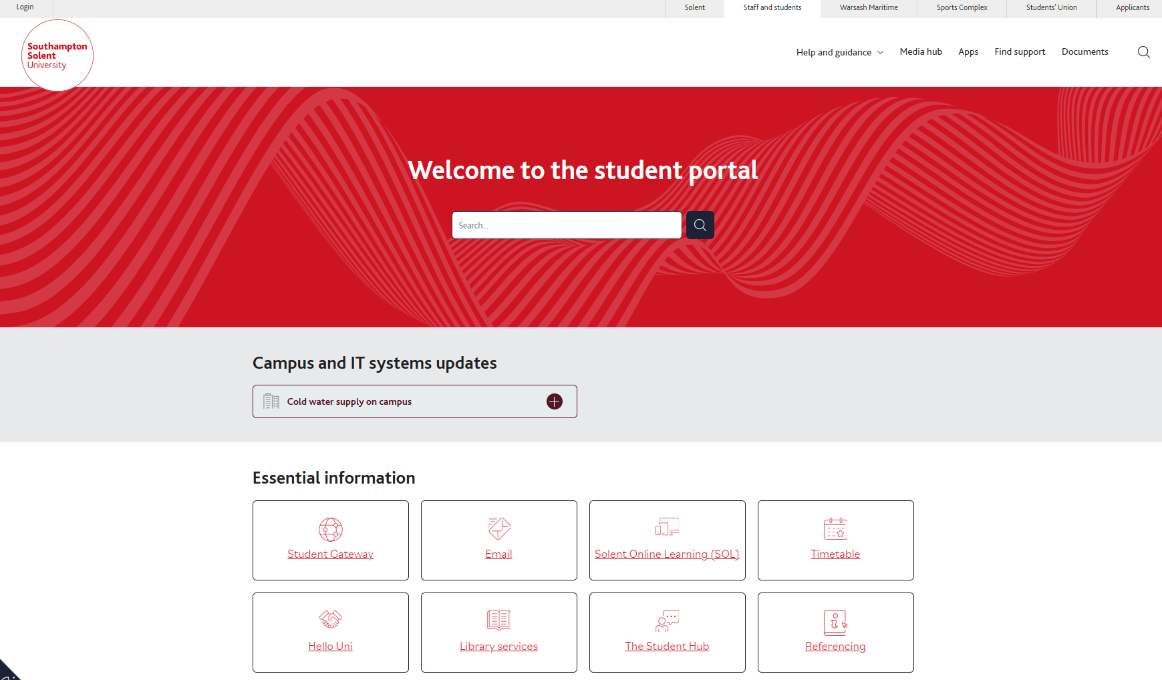
https://students.solent.ac.uk/

Slide 43
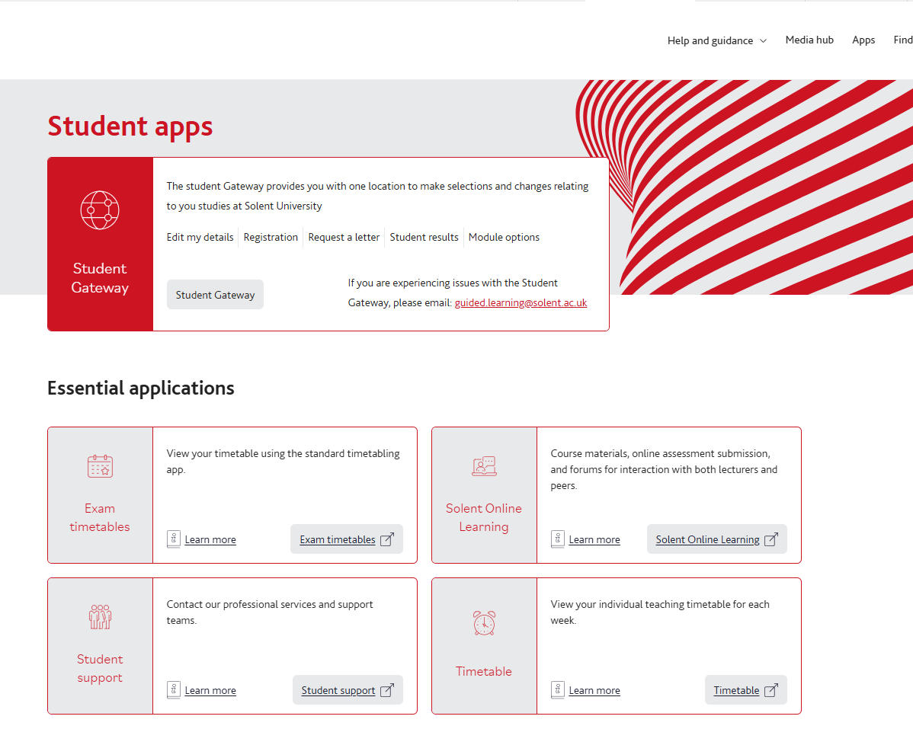

Slide 44
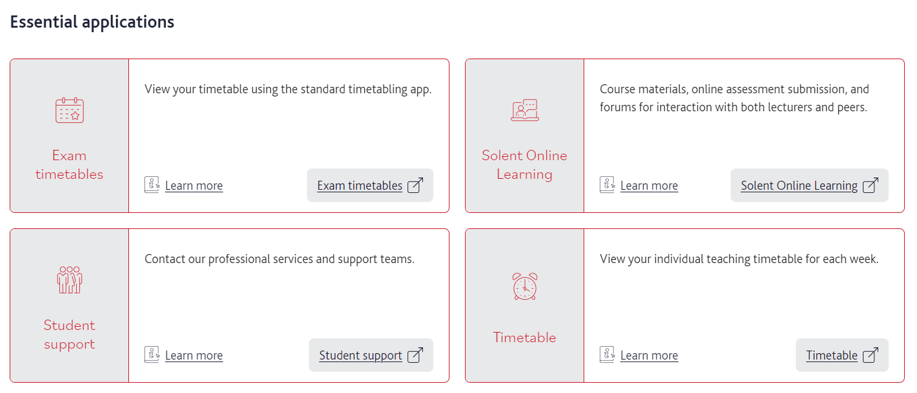

Slide 45
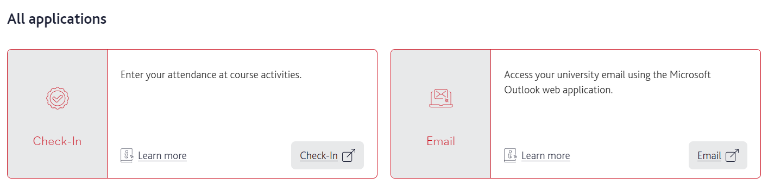

Slide 46
Timetabling & Attendance Monitoring

Slide 47
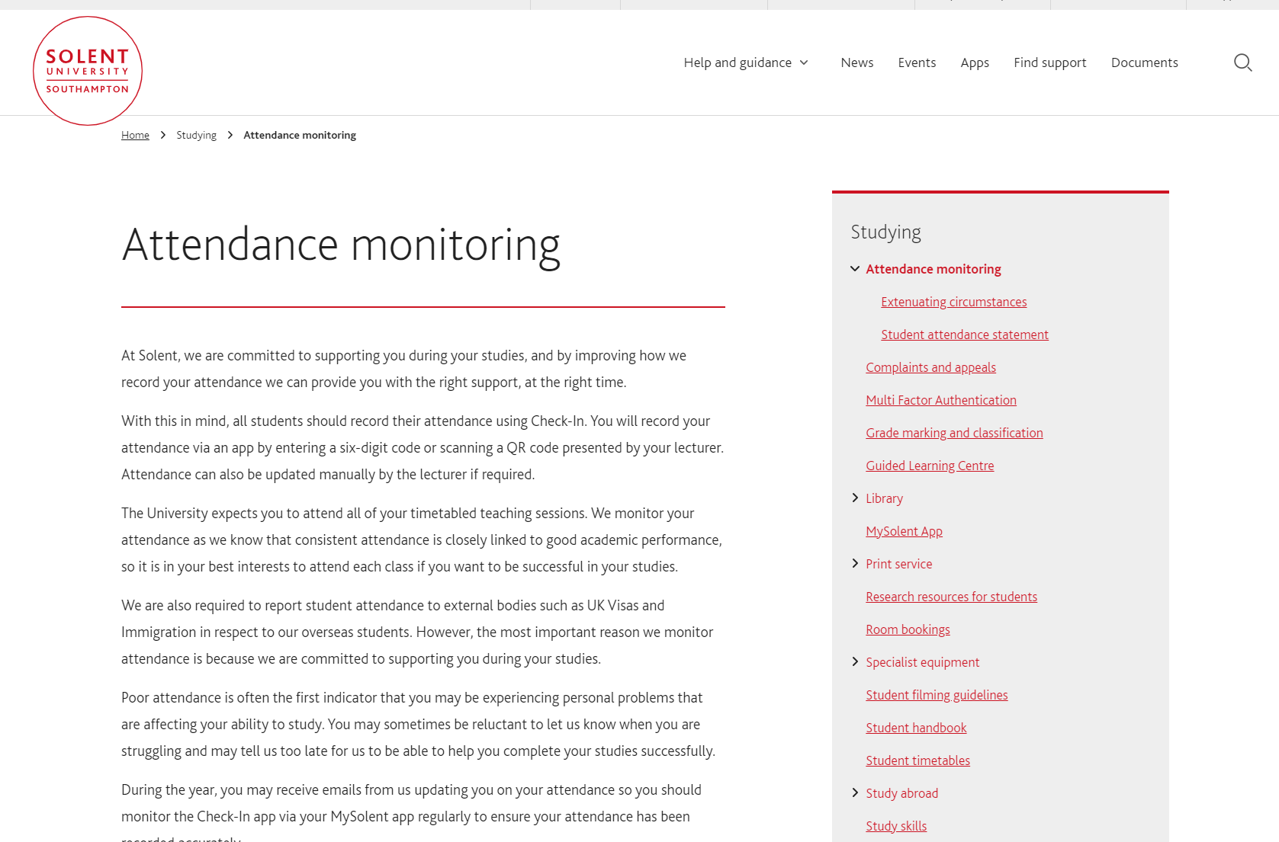
Attendance monitoring | Student portal

Slide 48

Check-in Getting started
Watch the video below to help you get started using the system, if you have any questions please see the FAQs. For all other attendance queries please email check-in@solent.ac.uk or visit the Student Hub.
Check-In video Check In training video for students_default.mp4 (sharepoint.com)
Attendance monitoring | Student portal

Slide 49

Campus card
Students should always have their campus card on them to ensure they can access both the campus buildings and the classrooms.

Slide 50
ASSESSMENTS & GRADING

Slide 51
Grades from first year (Level 4) do not count to your final degree classification
Final module grades need to average out at 40 to pass a Module
1 compensation will be awarded per level on a marginal fail between 30-39

Slide 52
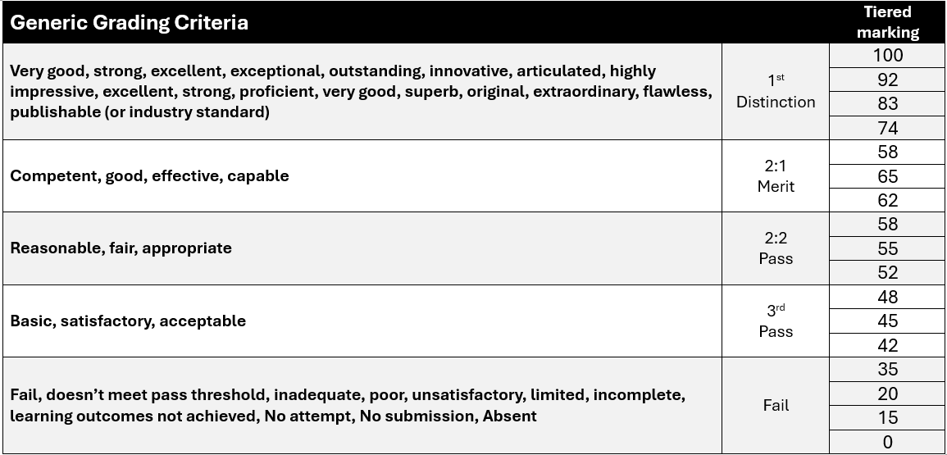

Slide 53
Refer
If you fail or don’t submit an assessment element/fail a module, you will be given a referral (a retake) which will be capped at 40%

Slide 54
Defer
If you apply for extenuating circumstances (EC) and are successful you will be given Deferral which is not capped.

Slide 55
Deferrals and referrals take place the first week in July for Under Graduates

Slide 56
EPA
Endpoint Assessment
Final 3 months of apprenticeship

Slide 57
Endpoint Assessment – BSc Digital & Technology Solutions
Project Report - AE1 with presentation, questions and answers This assessment method has 2 components: 1. Project with report - 6000 words (+/-10%) 2. Presentation with questions and answers 60 min (Presentation 30mins & 30mins Q&A) Assessment and grading will be undertaken by an independent assessor and be awarded the following grade based upon the criteria written in the standard. The project report with presentation, questions and answers is structured to give the apprentice the opportunity to demonstrate the KSBs.

Slide 58

PORTFOLIO
Throughout the apprenticeship you will need to keep a portfolio of work mapped to the standard KSBs, before Gateway you will need to select 6 discrete pieces of evidence for EPA assessment element 2 (AE2)

Slide 59
Endpoint Assessment – BSc Digital & Technology Solutions
Portfolio - AE2 - Professional Discussion underpinned by a portfolio. Professional Discussion – 60 minutes (+10% if necessary) Assessment and grading will be undertaken by an independent assessor and be awarded the following grade based upon the criteria written in the standard. n the professional discussion, an independent assessor and apprentice have a formal two-way conversation. It gives the apprentice the opportunity to demonstrate the KSBs mapped to this assessment method. The apprentice can refer to and illustrate their answers with evidence from their portfolio of evidence (6 items) previously submitted at Gateway.

Slide 60
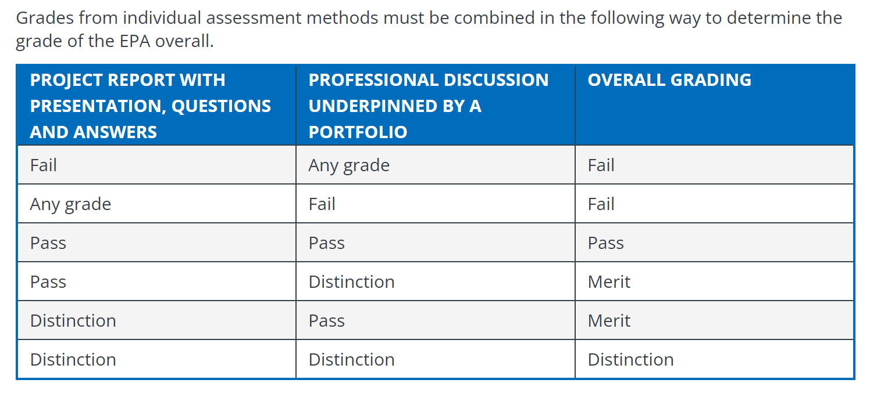

Slide 61
You must pass the degree to pass the apprenticeship and you must pass the apprenticeship to pass the degree

Slide 62
STUDENT COURSE REPRESENTATIVES

Slide 63
Course Reps - (run by Students’ Union)
Deadline for applications: 26/09/2025 at 5pm (one Course Rep per level, per course)
Course Reps must attend one training session. The training will be in The Workshop (JM108) on: 30/9/2025 2pm, 2/20/2025 5pm, 7/10/2025 1.30pm & 8/10/2025 11am

Slide 64
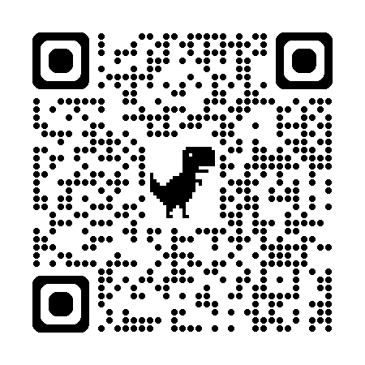
Course Reps - (run by Students’ Union)
Multiple Students Interested: All students should fill in the form and the decision will fall to the SU (previous Course Reps are favourable)
Link for students: https://5gecbr30.paperform.co

Slide 65

Thank you & Questions

